Slide 1
The University Teaching Fund:
Overview and open_innovation Information Event
  UZH Teaching Fund, Call for Proposals 2025
    Dr. Anna Leupold
    February 6th, 2025

Slide 2

UZH Teaching Fund (ULF) –
Background and Aim
Aim
The UZH Teaching Fund is an internal funding instrument designed to support anyone involved in teaching at UZH in the realization of innovative teaching projects. It has been launched to support the realization of the initiative „Future of Teaching at UZH“.
UZH Curriculum
The UZH curriculum defines university-wide quality standards for academic programs. Academic programs should be developed according to the following criteria:
  research-based
  goal-oriented
  engaging
  individualized
  transdisciplinary
  international
Design: Rosa Guggenheim

Slide 3







Overview of the ULF Funding Lines
open_innovation
Experimental innovation at module level
program_innovation
(Further) development of study programs
transdisciplinary_innovation
Strategic development of STS inter-/transdisciplinary courses
engage_now
Support student engagement that goes beyond the curriculum
global_innovation
Allow students to gain relevant international experience
focus_innovation
Define and support strategic focus topics (university-wide)
micro_innovation
Enable spontaneous (incremental) innovation

Slide 4





ULF Annual Calendar 2025
Spring Semester 2025
Fall Semester 2025
Open all year
Call for proposals:
Jan 15th – March 15th
Funding decision:
May 20th
Call for proposals:
Sep 15th – Nov 15th
Funding decision:
Dec 9th
Study program directors may contac the ULF-Management directly: info@ulf.uzh.ch
Call for proposals:
Sep 15th – Dec 15th
Funding decision:
March 2026
New projects are proposed and initiated in accordance with the priorities of the Vice-President EDU
Proposals may be handed in any time – find out more:
www.ulf.uzh.ch/en/micro_innovation
Proposals may be handed in any time – find out more:
www.ulf.uzh.ch/en/engage_now

Slide 5

open_innovation – Focus on Didactics
open_innovation | Kompetitiver Lehrkredit
Goal | Promotion of disruptive and experimental didactic innovations at module and course level and at teaching materials
Special Notes | Projects that are mindful of accessibility in the development and implementation of the project or its end product are especially welcome
Eligibility | UZH instructors
Duration | Maximum two years
Funding | Annual call for proposals for initial funding Maximum funding: CHF 30‘000

Slide 6

Goals open_innovation
  Testing or further development of innovative instructional methods and concepts (course and module level).
  (Further) development of teaching materials that can be used in the long term.
  Projects designed merely to develop or refine content will not be funded.
  Teaching projects should exceed the basic mandate of each faculty/institute.
  Not all content criteria must be met, but the evaluation by the allocation committee is based on them.
  The projects adhere to the UZH Diversity and Sustainability Policy.

Slide 7
Application and Award Process (expected)
Applicant/ project leader (Idea / Proposal)
Institute/Faculty (Approval/ Recommendation)
Educational Development (Assessment / Evaluation)
Commission Education and Student Affairs (Decision)
Write and submit proposal
Project
implementation
Approval for submission (SPrV)
Review of formal criteria and educational design
Communication of positive funding decision
Communication of rejection / offer to provide feedback
Discussion
Decision

Slide 8


Formal Criteria
Human resources
Equipment
The combined employment level may not exceed 100%;
Justification why the requested funds are needed;
Fixed sum for tutors, if needed
The amount spent on equipment must be reasonable and in line with the objectives of the project
Finances
Expenses
Use of funding in a purposeful manner (max. CHF 30’000);
Justification why additional funds are needed;
UZH profit center
Fixed expense sum of 300 CHF;
If higher expenses are requested, justification as to why these expenses contribute to the sustainability of the project is required

Slide 9
Funding Criteria
Student Involvement
Quality of Design/
Broad Impact
  Students and their perspectives are included in the conception, planning and reflection of the teaching project
  Educational design is transferable to other courses and subjects
  Insights gained are shared within and beyond the faculty
  Planned project will benefit many students
  Planned project provides a major benefit for large student cohorts
Sustainability
  Provisions are made for (possible) continuation of courses
  Innovative spirit of the project is not tied to a specific instructor, but is supported by the department or faculty
Effectiveness
  Projects are SMART
  Appropriate cost/benefit ratio
  Added value for students is evident
  Projects take accessibility into account
Innovation
  Innovative educational concept
  Learning objectives, learning activities, and assessments are closely aligned

Slide 10
Application – the Most Important Aspects
UZH Curriculum
Proposal makes reference to the goals of the initiative »Future of Teaching»
Educational Concept
It’s the educational concept that counts – not the content!
Justification
Demonstrate why financial support is needed to realize the project
Innovation
Demonstrate innovative added value; explicit reference to award criteria

Slide 11

Support during the Application Process and Beyond
Counseling
Comprehensive advice during the application process (mail/Teams/etc.)
Project Support
Support team accompanies the entire project including UZH knowledge transfer
Community
Attractive networking opportunities, peer learning

Slide 12

Timeline open_innovation
August 1st, 2025
Earliest project start date for approved projects
May 20th, 2025
Funding decision of Commission for Education and Student Affairs
March – May 2025
Review of the proposals received in 2025
March 15th, 2025
Deadline for proposals

Slide 13
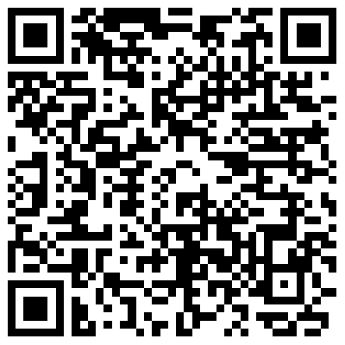
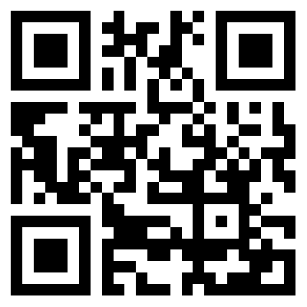
Important links and resources
Link to call for proposals
Link to web tool for submitting proposals
Important note on porposals, which focus on the implementation of plattforms, apps, AI-tools, etc.
Please check whether your application affects aspects of IT security and data protection and make sure that you do not want to purchase any new IT-solutions for which UZH already offers equivalent solutions.
Important information can be found here:
https://www.zi.uzh.ch/apps/service-catalog/de?q=%2A&size=n_10_n
Please do not hesitate to contact the ULF-Team: open@ulf.uzh.ch

Slide 14

Dr. Anna Leupold
ULF-Management
anna.leupold@uzh.ch
+41 44 634 40 02
Discover more about ULF!
info@ulf.uzh.ch
www.ulf.uzh.ch

Slide 15
